Slide 1
Chapter 11: Linear Regression
E370, Spring 2016

Slide 2
From Simple Regression to Multiple Regression
Recall in two-variable analysis, we can add a least squares line to our scatter plot to explain the linear relationship between two variables: $Y^{′}=b_{1}X+b_{0}$
In some cases, we want to simultaneously understand the relationship between several explanatory variables and the outcome of interest.
$$Y=β_{0}+β_{1}X_{1}+β_{2}X_{2}+…+β_{K}β_{K}+ε$$
So we extend the framework of single regressions to be multiple regressions.
$$Y^{′}=b_{0}+b_{1}X_{1}+b_{2}X_{2}{+…+b}_{K}X_{K}$$
The model is estimated minimizing the sum of squared errors (SSE)
$$SSE=\sum_{i=1}^{n}{{(Y_{i}−Y_{i}^{′})}^{2}}$$

Slide 3
Important Concepts
Variables:
Dependent variable: Y, to be explained
Independent variable: X’s, numerical variables or dummy variables
Assumption:
linear relationship,
uncorrelated independent variables,
the error term is normally distributed, centered at 0, and has a constant variance over the full range of the dependent variable.

Slide 4
Multiple Regression in Excel
Data---Data Analysis---Regression

Slide 5
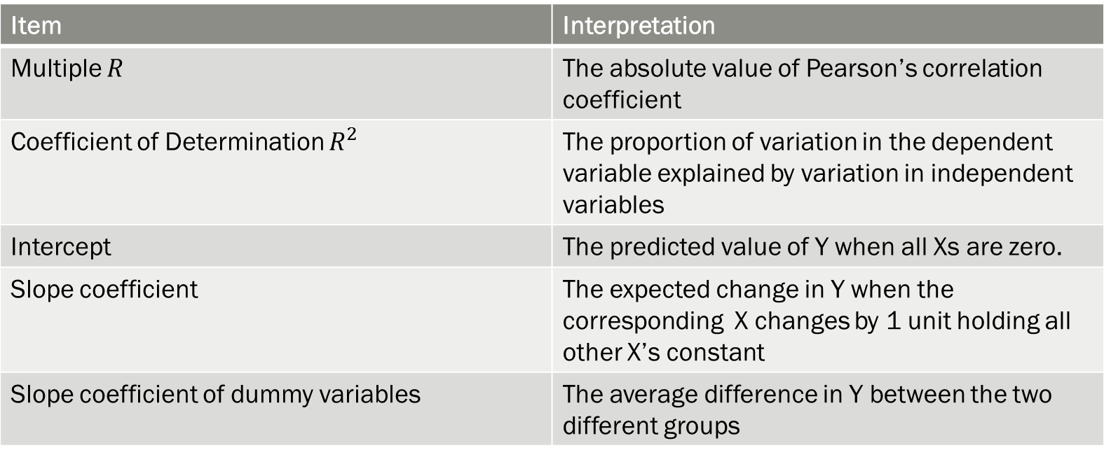
Interpretations
Item | Interpretation
Multiple $R$ | The absolute value of Pearson’s correlation coefficient
Coefficient of Determination $R^{2}$ | The proportion of variation in the dependent variable explained by variation in independent variables
Intercept | The predicted value of Y when all Xs are zero.
Slope coefficient | The expected change in Y when the corresponding X changes by 1 unit holding all other X’s constant
Slope coefficient of dummy variables | The average difference in Y between the two different groups

Slide 6
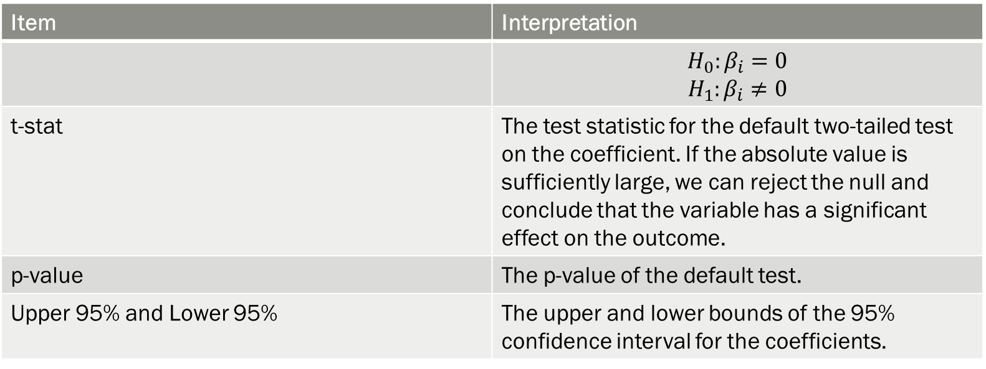
Statistic Tests
Item | Interpretation
 | $$H_{0}:β_{i}=0$$ $$H_{1}:β_{i}≠0$$
t-stat | The test statistic for the default two-tailed test on the coefficient. If the absolute value is sufficiently large, we can reject the null and conclude that the variable has a significant effect on the outcome.
p-value | The p-value of the default test.
Upper 95% and Lower 95% | The upper and lower bounds of the 95% confidence interval for the coefficients.

