Slide 1
Chapter 8: The distribution of statistics
E370 Spring 2016

Slide 2
Concepts:
The sample mean and sample proportion are estimators of the population mean and population proportion, respectively.
Why are sample mean and sample proportion random variables?
The distribution of a (sample) statistic is called a “sampling distribution”. CLT is applied to sampling distribution.

Slide 3
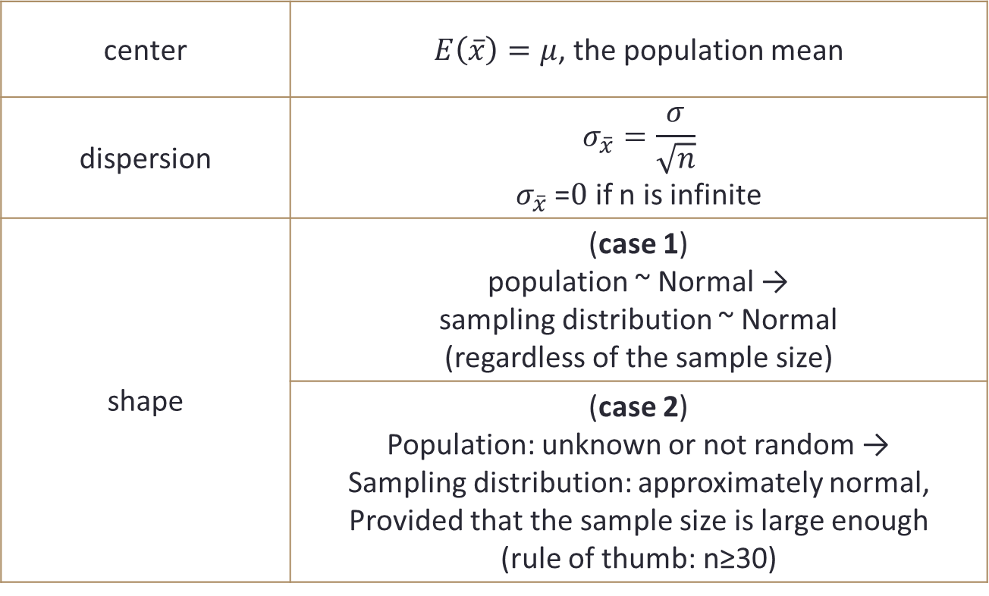
A. Central Limit Theorem for the sample mean
center | $E\left(\overline{x}\right)=μ$, the population mean
dispersion | $$σ_{\overline{x}}=\frac{σ}{\sqrt{n}}$$ $σ_{\overline{x}}$ =$0$ if n is infinite
shape | (case 1) population ~ Normal → sampling distribution ~ Normal (regardless of the sample size)
 | (case 2) Population: unknown or not random → Sampling distribution: approximately normal, Provided that the sample size is large enough (rule of thumb: n≥30)

Slide 4
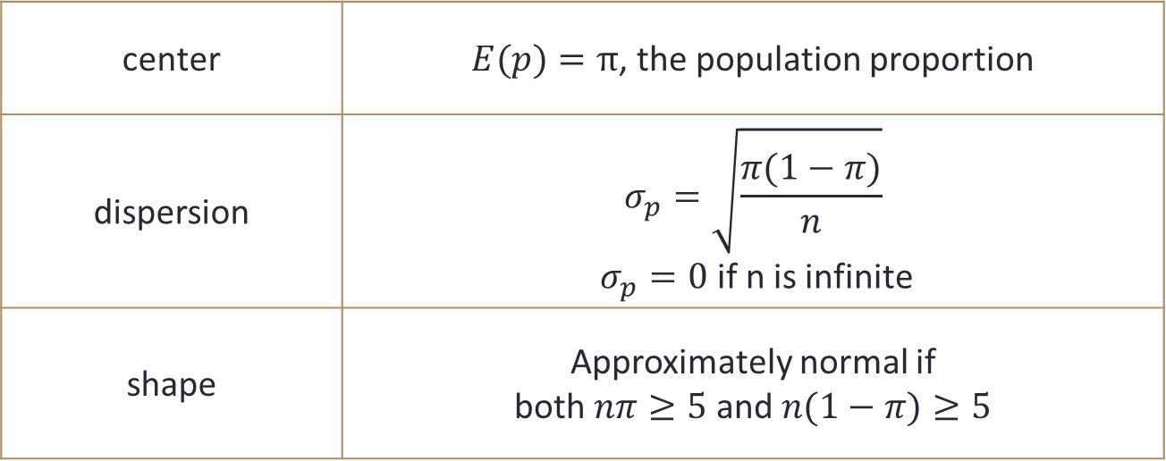
B. Central Limit Theorem for the sample proportion
center | $E(p)=π$, the population proportion
dispersion | $$σ_{p}=\sqrt{\frac{π(1−π)}{n}}$$ $σ_{p}=0$ if n is infinite
shape | Approximately normal if both $nπ≥5$ and $n(1−π)≥5$
Note: The theorem does not apply if either of the two criteria fails.

Slide 5
C. Why is CLT important?
Even if we do not know the distribution of the population, or the population distribution is not normal, we can judge whether the sampling distribution follows normal distribution by CLT.
If we know sample statistic follows a normal distribution, we can apply “NORM.DIST” to calculate the probability, but remember to use the correct standard error for sample mean/sample proportion.

Slide 6
C. Excel Commands
Excel Functions | Returns
=NORM.DIST(x,μ,σ,1) | P(X<x)
=NORM.INV(π,μ,σ) | x Such that P(X<x)=π
=NORM.S.DIST(z,1) | P(Z<z)
=NORM.S.INV(π) | z such that P(Z<z)=π
=T.DIST(t,df,1) | P(T<t)
=T.INV(π,df) | t such that P(T<t)=π

